Slide 1
Code Deploy
Presented by Pratiksha M

Slide 2
Agenda
  Introduction
Benefits of AWS CodeDeploy
  Architecture of Code Deploy
  Basic configuration
  Basic Commands
  Advantage
  Difference Between commands
  Branching in Mercurial
  Mercurial code hosting

Slide 3
INTRODUCTION
  AWS Code Deploy is a service that automates code deployments to Elastic Compute Cloud (EC2) and on-premises servers.
  Accelerating how fast a developer can release code allows him to release new features for an application faster and avoid deployment errors in complex applications.

Slide 4
Benefits of AWS CodeDeploy
Automated deployments.
Minimize downtime.
Centralized control.
Easy to adopt

Slide 5
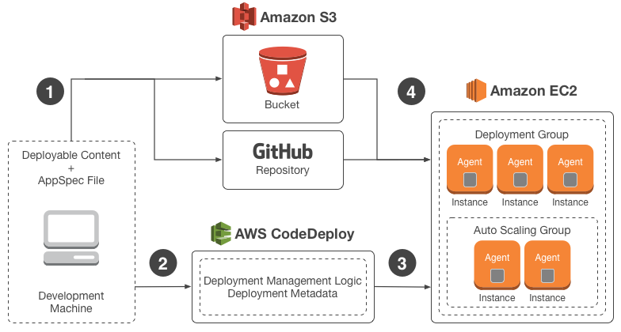
Architecture of Code Deploy

Slide 6
Basic Settings
Sign Up for AWS
Provision an IAM User
Install or Upgrade and Then Configure the AWS CLI
Create an IAM Instance Profile and a Service Role

Slide 7
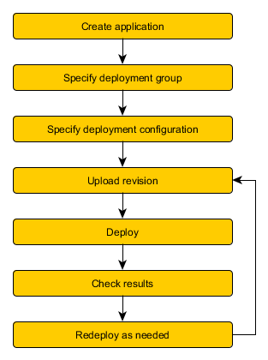
Deployment Workflow

Slide 8
Step 1 : Welcome
Step 2 : Instance Settings
Step 3 : Application Name
Step 4 : Revision
Step 5 : Deployment Group
Step 6 : Service Role
Step 7 : Deployment Configuration
Step 8 : Review

Slide 9
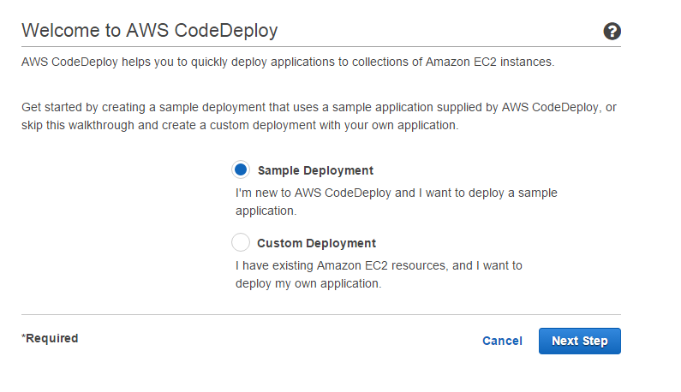

Slide 10
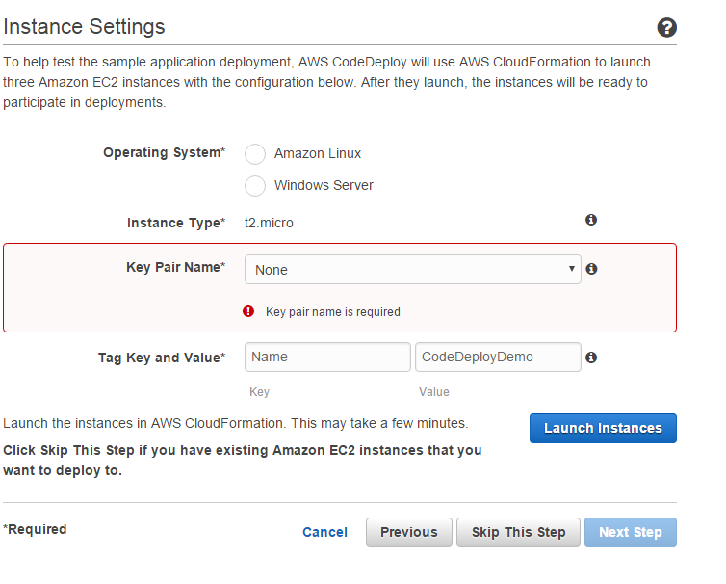

Slide 11
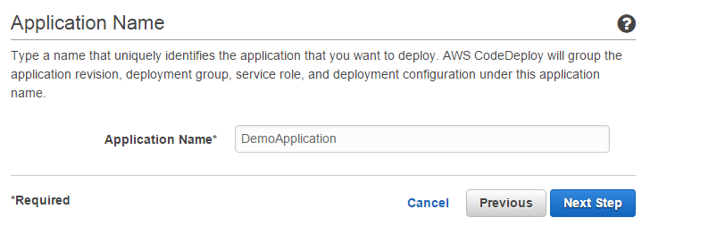

Slide 12
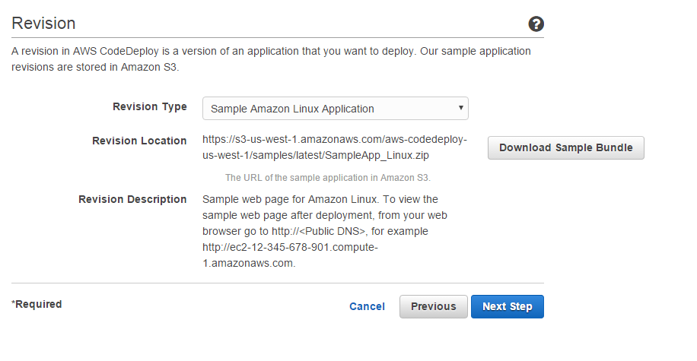

Slide 13

Any Questions?

Slide 14
Thank You!

